Slide 1
A.P. World History
Unit 1: Through 600 C.E.

Slide 2
Period 1 Key Concepts
Key Concept #1: Big Geography and the Peopling of the Earth.
Key Concept #2: The Neolithic Revolution and Early Agricultural Societies.
Key Concept #3: The Development and Interaction of Early Agricultural, Pastoral, and Urban Societies.

Slide 3
Key Concept 1.1
Big Geography and the Peopling of the Earth
Throughout the Paleolithic period, humans migrated from Africa to Eurasia, Australia, and the Americas.
  Known as the Out of Africa Theory: uses archeological evidence to prove that humans originate in Africa and then spread.
Early humans were mobile and creative in adapting to different geographical settings and lived in hunter-gatherer societies.
  Small kinship based groups estimated between 30-50 people
  By studying modern hunter-forager societies, anthropologists infer that these bands were relatively egalitarian.
Notes:
Note: Mobile is a relative term, todays humans can span the globe in a matter or hours, however this migration (mapped on the next slide) took thousands of years.

Slide 4
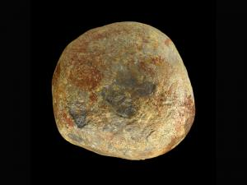
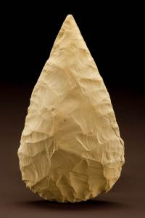
Key Concept 1.1
Big Geography and the Peopling of the Earth
Archeological evidence indicates that as we moved out of Africa we adapted technology to suit us.
  We used fire in new ways:
    Aid hunting and foraging
    Protect against predators
    Adapt to cold environments
  We developed a wide range of tools specific to their environment.
  We developed the beginnings of economies:
    Small kinship groups of hunting-foraging bands that could make what they needed to survive.
    As they moved they exchanged people, ideas, and goods.
Notes:
Hammerstone and Handaxe to Bone Needles and Harpoons 120,000-12,000 Years ago…

Slide 5
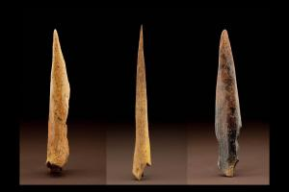
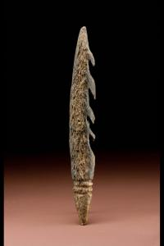
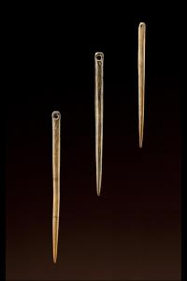
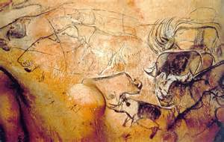
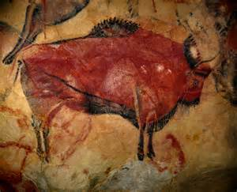
Key Concept 1.1
Big Geography and the Peopling of the Earth
Chauvet Cave, France
Altimara, Spain
Notes:
Hammerstone and Handaxe to Bone Needles and Harpoons 120,000-12,000 Years ago…
Cave art from Paleolithic Culture

Slide 6
Key Concept 1.2
The Neolithic Revolution and Early Agricultural Societies.
Beginning about 10,000 years ago humanity experience the Neolithic Revolution…
  Possibly as a response to warming climates at the end of the last Ice Age, from about 10,000 years ago.
  Permanent agricultural villages appear independently in several locations around the world (Map Activity Part 2)
  Creates a more reliable food supply
    HOWEVER: Not necessarily a more diversified food supply.
Pastoralism also develops at various grassland sites in Afro-Eurasia.
  Like agriculturalists, pastoralists tended to be more socially stratified than hunter-foragers.
  Because pastoralists were mobile, they rarely accumulated large amounts of material possessions, which would have been a hindrance when they changed grazing areas.
  The pastoralists’ mobility allowed them to become an important conduit for technological change as they interacted with settled populations.
Notes:
Students should be getting the bold words out of their textbook readings. I also like to define Afro-Eurasia

Slide 7
Key Concept 1.2
The Neolithic Revolution and Early Agricultural Societies.
Agriculturalists/Pastoralists impact the environment:
  Intensive cultivation of selected plants to the exclusion of others.
  The construction of irrigation systems
  The use of domesticated animals for food and for labor
  Overgrazing large numbers of animals on fragile grasslands
  Possible negative features of the Neolithic Revolution…
    Patriarchy and forced labor systems developed, giving elite men concentrated power over most of the other people in their societies.
      Elite groups accumulated wealth, creating more hierarchical social structures, and promoted patriarchal forms of social organization.
Transformation of human societies:
  Surpluses of food and other goods led to specialization of labor, including new classes of artisans and warriors, and the development of elites.
  Technological innovations led to improvements in agricultural production, trade, and transportation.
    Pottery, Plows, Woven Textiles, Metallurgy, Wheels and wheeled devices
  Agricultural communities had to work cooperatively to clear land and create the water control systems needed for crop production
Notes:
I like to talk the technological innovations through with the students. What do each of these technologies allow humans to do?
Pottery: Store grains, water, agricultural products (including alcohol)
Plows: Allows for larger croup yields and easier tilling of the soil
Woven Textiles: Live in different climates, use for sheep, Specialization of Labor
Metallurgy: Working with metal (all the toolkit tools now made with iron rather than stone/bone)
Wheels: Faster and easier transportation of heavy loads.

Slide 8
Key Concept 1.3
The Development and Interaction of Early Agricultural, Pastoral, and Urban Societies.
In the areas of agricultural development, seven core foundational civilizations develop and flourish.
    Within these areas the first states emerge:
      Mobilized surplus labor and resources over large areas
      Led by rulers whose source of power was believed to be divine or had military support.
      Exploited nearby resources such as iron and other trade resources
      Interacted with other states and pastoral societies that diffused new technology (especially weapons)
        Compound Bows, Iron Weapons, Horseback Riding, Chariots
    These first states were unified by culture which played a role in: laws, language, literature, religion, myths, and monumental art/architecture.
      Ziggurats, Pyramids, Temples
      Infrastructure: Defensive Walls, Streets and Roads, Sewage and Water Systems
      Sculpture, Painting, Wall Decorations, Elaborate Weaving (Promoted by Elites)
Notes:
I try to juxtapose the kinship groups of hunters and gatherers with the far more developed state systems that develop.

Slide 9
Key Concept 1.3
The Development and Interaction of Early Agricultural, Pastoral, and Urban Societies.
First States (Continued) Developed:
  Systems of record keeping arose independently in all early civilizations and subsequently were diffused:
    Cuneiform, Hieroglyphs, Pictographs, Alphabets, Quipu
  Legal codes that reflect the hierarchies involved (Code of Hammurabi)
  Support unified religions such as The Vedic, Hebrew, and Zoroastrianism.
  Trade expanded throughout this period with civilizations exchanging goods, cultural ideas, and technology.
    Egypt-Nubia & Mesopotamia-Indus
  Hierarchical Structures for society and genders
  Literature: The Rig Veda, The Epic of Gilgamesh, and The Book of the Dead.
Notes:
There is a difference between record keeping and writing. Especially in L.A., Africa, and Initially India
Archeological and in many cases recorded evidence suggests strong trade ties between Egyt and Nubia as well as Mesopotamia and the Indus R.V.

Slide 10
Period 2
Key Concepts

Slide 11
Period 2 Key Concepts
Key Concept #1: The Development and Codification of Religious and Cultural Traditions.
Key Concept #2: The Development of States and Empires.
Key Concept #3: Emergence of Trans-regional Networks of Communication and Exchange.

Slide 12

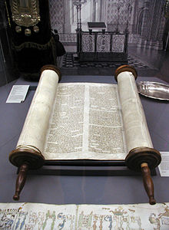

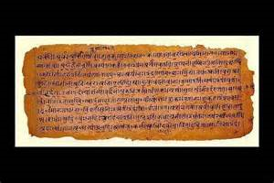
Key Concept 2.1
The Development and Codification of Religious and Cultural Traditions.
Codifications and further developments of existing religious traditions provided a bond among the people and an ethical code to live by:
Codified implies that the beliefs, morals, and rituals of a particular religion are recorded in a written document(s).
  Judaism (Hebrews) have the Tanakh (Bible), Talmud, and other texts such as the Dead Sea Scrolls.
  Hinduism have two basic types of sacred text Shruti (That which is revealed) and Smriti (That which is learned).
    The Four Vedas are Shruti, written in sanskrit and the first was written between 1500-1100B.C.E.
    Later writings are considered Smriti and some have been written as late as 1400 C.E.

Slide 13
Key Concept 2.1
The Development and Codification of Religious and Cultural Traditions.
Judaism (Monotheistic) was developed with the codification of the Hebrew Scriptures, which also reflected the influence of Mesopotamian cultural and legal traditions.
  Abraham was a citizen of Ur (Sumerian) before traveling to the Levant (Promised Land).
  Rules and Laws written out in the Hebrew Scriptures similar to the Code of Hammurabi.
  Themes from the Epic of Gilgamesh and other myths and legends of Mesopotamia can be found in the Hebrew Scriptures (and consequently the Christian Bible).
The Assyrian (8th Century BCE), Babylonian (5th Century BCE), and Romans (1st Century BCE-3rd Century CE) conquered various Jewish states at different points in time.
  These conquests contributed to the growth of Jewish diasporic communities around the Mediterranean and Middle East.

Slide 14
Key Concept 2.1
The Development and Codification of Religious and Cultural Traditions.
The core beliefs outlined in the Sanskrit scriptures formed the basis of the Vedic religions-later known as Hinduism.
These Vedic teachings contributed to the development of the social and political roles of a caste system.
  The importance of multiple manifestations of Brahma to promote teachings about reincarnation.
Concepts of Karma, Dharma, and Moksha
  Moral Law of Cause and Effect
  The Right Way of Living
  Release from the cycle of death and rebirth

Slide 15
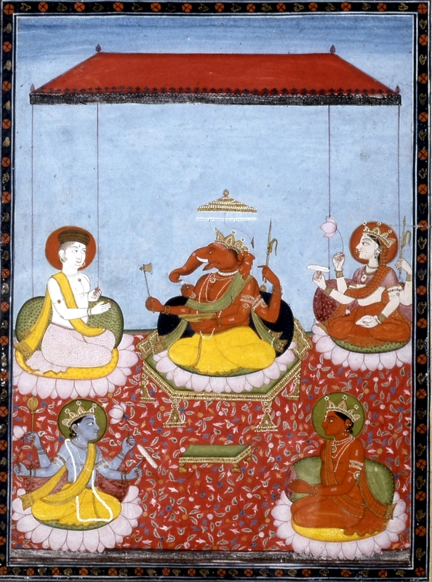
Hinduism
Polytheistic (Multiple Gods)
  Ganesh (center) remover of obstacles, patron of art/science, god of intellect and wisdom.
  Shiva (top left) The Destroyer/Transformer, both fearsome and benevolent.
  Vishnu (bottom left) The Preserver.
  Devi (top right) Goddess of balance.
  Surya (bottom right) Sun God

Slide 16
Key Concept 2.1
The Development and Codification of Religious and Cultural Traditions.
New belief systems and cultural traditions emerged and spread, often asserting universal truths:
  Buddhism: began as a reaction to the Vedic beliefs and rituals (Early Hinduism). Concepts of desire, suffering, and enlightenment.
  Confucianism: Originating from the writings of Confucius that promoted social harmony by outlining the rituals and proper social relationships.
  Daoism: Another set of writings influencing indirectly the Chinese political system and directly influence Chinese culture.
  Christianity: Based on the core teachings and belief in the divinity of Jesus of Nazareth. Written by his disciples and drawing from Judaism.
  Greco-Roman Philosophy: These philosophical and scientific writings emphasize logic, empirical observation, and the nature of political power and hierarchy

Slide 17
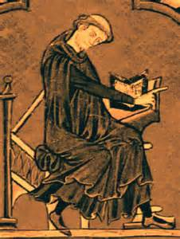
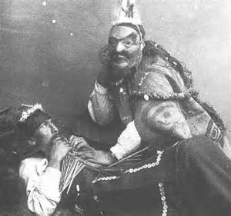
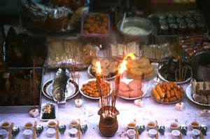
Key Concept 2.1
The Development and Codification of Religious and Cultural Traditions.
Belief systems affected gender roles. Buddhism and Christianity encouraged monastic life and Confucianism emphasized filial piety.
Shamanism and Animism continued to shape the lives of people within and outside of core civilizations because of their daily reliance on the natural world.
Ancestor veneration persisted in many regions.
  Africa
  The Mediterranean Region
  East Asia
  The Andean Areas

Slide 18
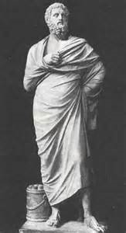
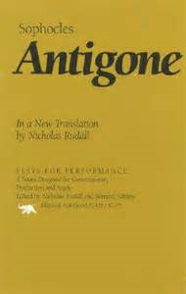
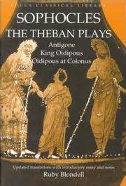
Key Concept 2.1
The Development and Codification of Religious and Cultural Traditions.
Artistic Expressions, including literature and drama, architecture, and sculpture, show distinctive cultural developments.
  Literature and drama acquired distinctive forms that influenced artistic developments in neighboring regions and in later time periods.
    Greek Plays
    Indian Epics

Slide 19
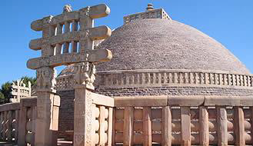
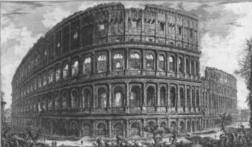
Key Concept 2.1
The Development and Codification of Religious and Cultural Traditions.
Distinctive architectural styles developed in many regions in this period.
  India (Temples)
  Greece (Temples)
  The Roman Empire
  Mesoamerica (Pyramids)
The convergence of Greco-Roman culture and Buddhist beliefs affected the development of unique sculptural developments.

Slide 20
Key Concept 2.2
The Development of States and Empires
The number and size of key states and empires grew dramatically by imposing political unity on areas where previously there had been competing states.
Must Know Examples:
  Persian Empire 550-330 BCE
  Qin 221-206 BCE
  Han 206 BCE - 220 CE
  Maurya 322-163 BCE
  Gupta 320-550 CE
  Phoenicia, 1500-539 BCE
  Greece (x2), Ancient: 5th/4th Century BCE & Hellenistic: 323 BCE
  Rome 27 BCE – 1453 CE (Republic 509-27 BCE)
  Teotihuacan 200 BCE–700 CE
  Maya & 200 BCE–900 CE
  Moche 1-800 CE

Slide 21
Key Concept 2.2
The Development of States and Empires
Empires and states developed new techniques of imperial administration based, in part, on the success of earlier political forms.
  Organization of Subjects:
    Creation of regional administrative regions within empires. Some of these are highly centralized while others rely on elaborate legal systems and bureaucracies.
Imperial governments projected military power over larger areas using a variety of techniques.
  Diplomacy
  Developing Supply Lines
  Building Fortifications, Defensive Walls, and Roads
  Drawing new groups of military officers and soldiers from the local populations or conquered peoples.

Slide 22
Key Concept 2.2
The Development of States and Empires
Much of the success of the empires rested on their promotion of trade and economic integration by building and maintaining roads and issuing currencies.
Cities served as centers of trade, public performance of religious rituals, and political administration for states and empires.
Imperial societies relied on a range of methods to maintain the production of food and provide rewards for the loyalty of the elites.
  Corvee (forced labor system)
  Slavery
  Rents and tributes
  Peasant Communities
  Family and household production

Slide 23
Key Concept 2.2
The Development of States and Empires
Empires create political, cultural, and administrative difficulties, which eventually led to their decline, collapse, and transformation into successor empires or states.
  The Roman, Han, Persian, Mauryan, and Gupta all experience these difficulties due to:
Excessive mobilization of resources, imperial governments caused environmental damage and generated social tensions and economic difficulties by concentrating too much wealth in the hands of elites.
  Deforestation Example Handout.
External problems resulted from security issues along their frontiers including the threat of invasions.
  Fall of Empires Handout.

Slide 24
Key Concept 2.3
Emergence of Transregional Networks of Communication and Exchange.
Land and water routes became the basis for transregional trade, communication, and exchange networks in the Eastern Hemisphere.
New technologies facilitated long-distance communication and exchange.
Alongside the trade in goods, the exchange of people, technology, religious and cultural beliefs, food crops, domesticated animals, and disease pathogens developed.

Slide 25
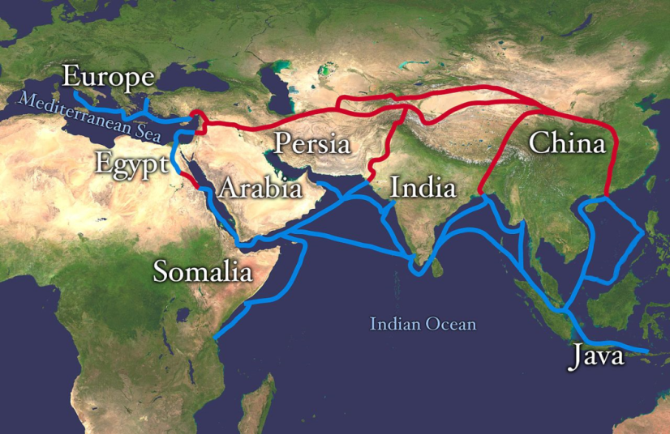
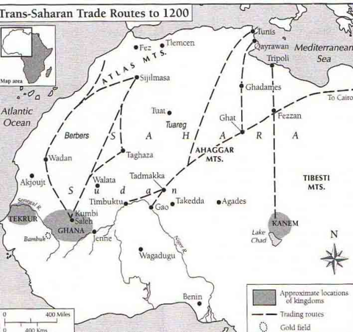
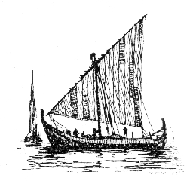
Key Concept 2.3
Emergence of Transregional Networks of Communication and Exchange.
Many factors, including the climate and location of the routes, the typical trade goods, and the ethnicity of people involved, shaped distinctive features of a variety of trade routes.
  Important Trade Routes:
    Eurasian Silk Roads
    Trans-Saharan Caravan Routes
    Indian Ocean Sea Lanes
    Mediterranean Sea Lanes
Notes:
Students need to know these routes and study them from their textbooks!

Slide 26
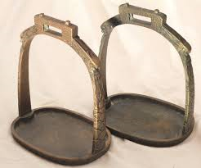
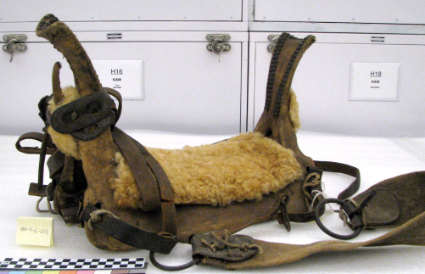
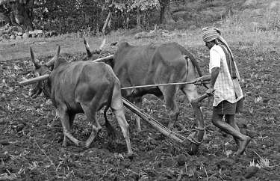
Key Concept 2.3
Emergence of Transregional Networks of Communication and Exchange.
New technologies permitted the use of domesticated pack animals to transport goods across longer routes.
  New technology:
    Yokes
    Saddles
    Stirrups
  Domesticated pack animals:
    Horses: Central Asia
    Oxen
    Llamas: S. America
    Camels: Saharan Africa & SW Asia
  Innovations in maritime technologies, as well as advanced knowledge of the monsoon winds, stimulated exchanges along maritime routes from East Africa to East Asia:
    Lateen Sail
    Dhow
Notes:
Yokes allow for better plowing and less farm labor
Saddles provide comfort and stability
Stirrups allow for stability and weapon use on horseback (allows less athletic to be more effective)

Slide 27
Key Concept 2.3
Emergence of Transregional Networks of Communication and Exchange.
The spread of crops, including rice and cotton from South Asia to the Middle East, encouraged changes in farming and irrigation techniques.
    The Qanat system
The spread of disease pathogens diminished urban populations and contributed to the decline of some empires.
    The Roman Empire
    The Chinese Empire
Religious and cultural traditions were transformed as they spread.
  Examples of transformed religious and cultural traditions:
    Christianity
    Hinduism
    Buddhism
Notes:
Qanat system: Persian Irrigation system.

Slide 28
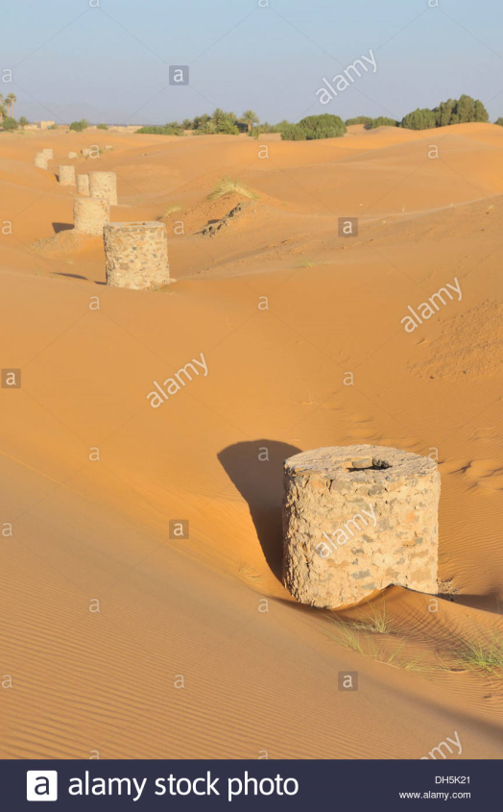
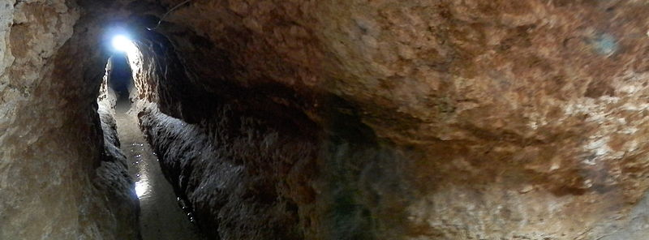
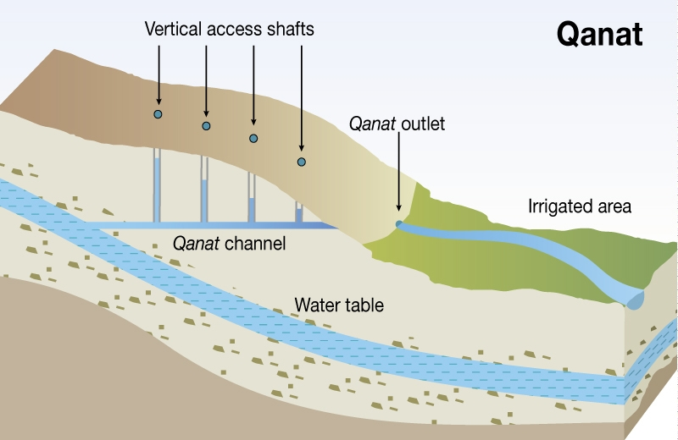
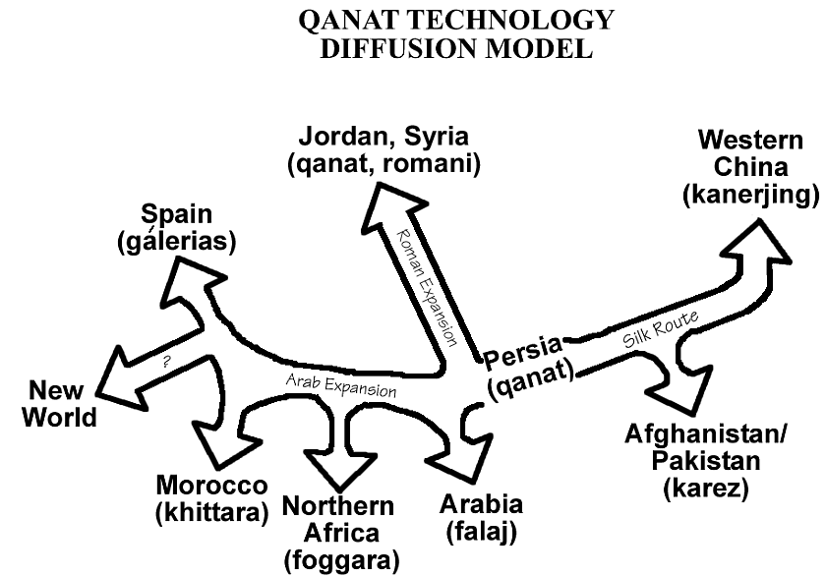
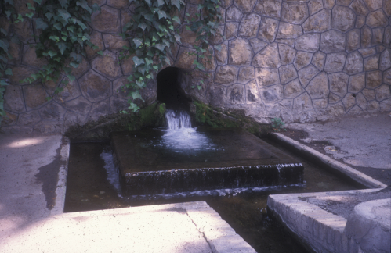
Qanat

