Slide 1
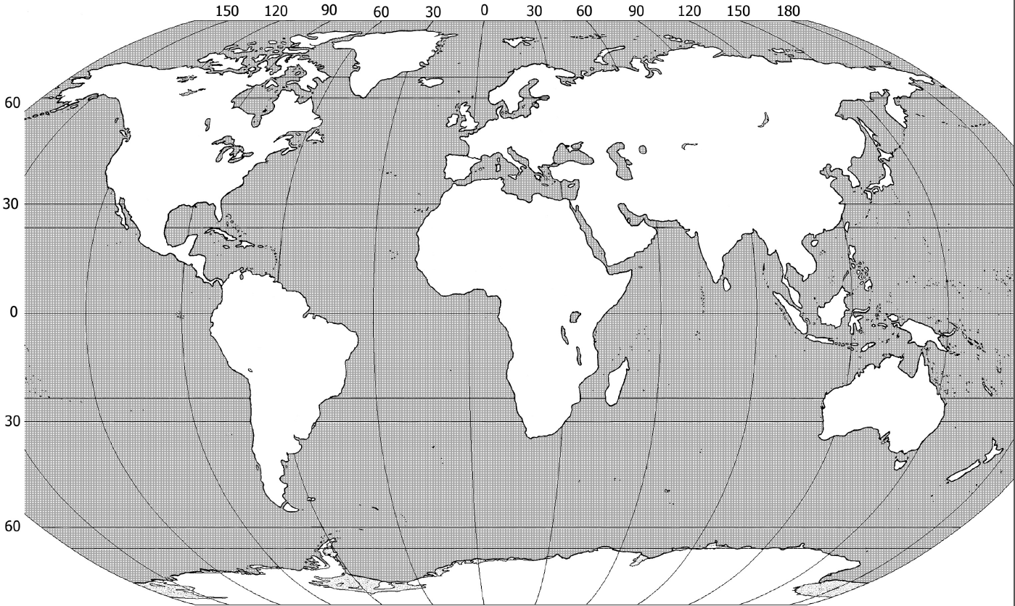
Map Activity Part 1
Between 200 and 250 Thousand Years ago Homo Sapiens emerge in Africa.
About 100,000 Years ago we see the first migrations of humans out of Africa.
About 70,000 Years ago we see the first appearance in Asia.
About 40 to 60 Thousand Years ago we see the first appearance of humans in Australia.
About 45 Thousand Years ago we see the first appearance of humans in Europe.
About 30 to 15 Thousand Years ago we see the first appearance of humans in North America.
About 12,500 Years ago humans have migrated to the bottom of South America.
Notes:
This is the first map activity. I have students complete their maps right along with me as I go through the points/animations. Mention the “Land Bridge” Theory with animation #6 which has humans crossing the Bering Strait into Alaska. At the end I also mention the alternative land bridge theory that humans migrated from Europe to N. America

Slide 2
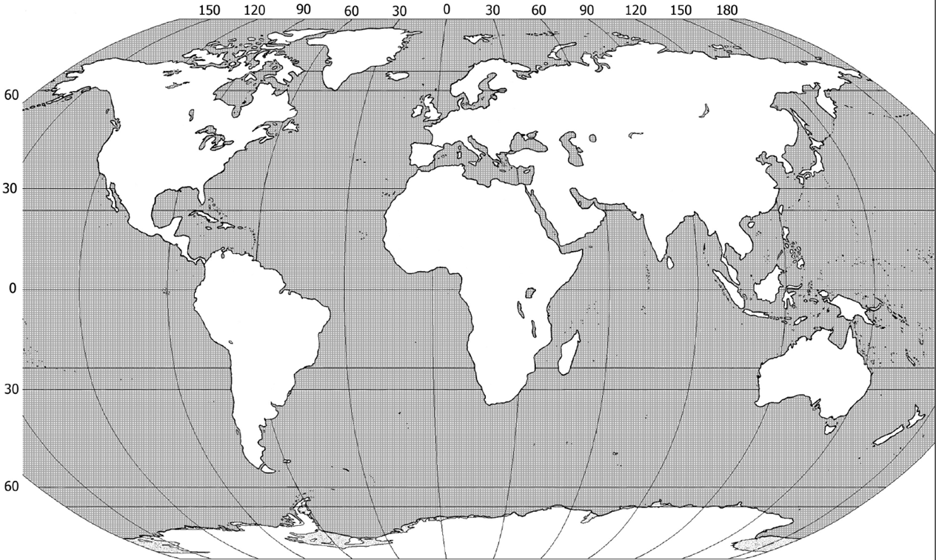
Map Activity Part 2
Mesopotamia
Egypt
The Indus Valley
China
Sub Saharan Africa
Mesoamerica
The Andes of South America

Slide 3
Map Activity 3
Mesopotamia (Sumer) Tigris and Euphrates River Valleys
Egypt in the Nile River Valley
The Indus River Valley (Harappa & Mohenjo-Daro)
China (Shang) Yellow River Valley
Mesoamerica (Olmec)
The Andes of South America (Chavin)
Notes:
I try to address any questions about what happens in Africa in a number of ways:
They come back into play in the next time period
Our knowledge is poor but emerging about ancient Africa
The Split between North and Sub Saharan Africa

Slide 4
Map Activity 4
Notes:
I try to address any questions about what happens in Africa in a number of ways:
They come back into play in the next time period
Our knowledge is poor but emerging about ancient Africa
The Split between North and Sub Saharan Africa

Slide 5
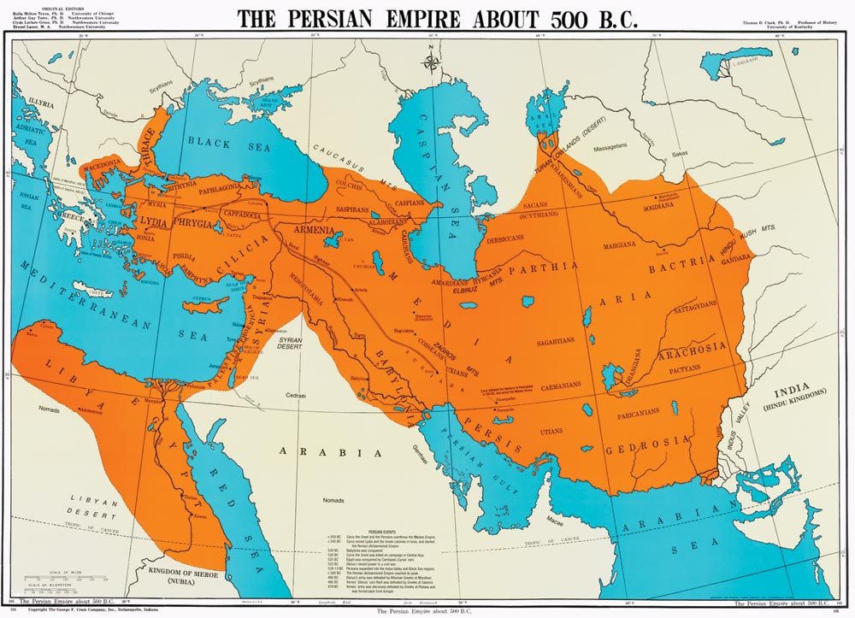
Persian Empires
Notes:
Persian Empire

Slide 6
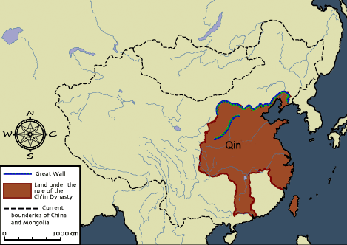
Chinese Empires
Notes:
Qin Empire

Slide 7
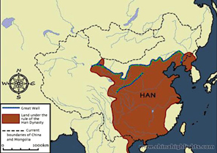
Chinese Empires
Notes:
Han Empire

Slide 8
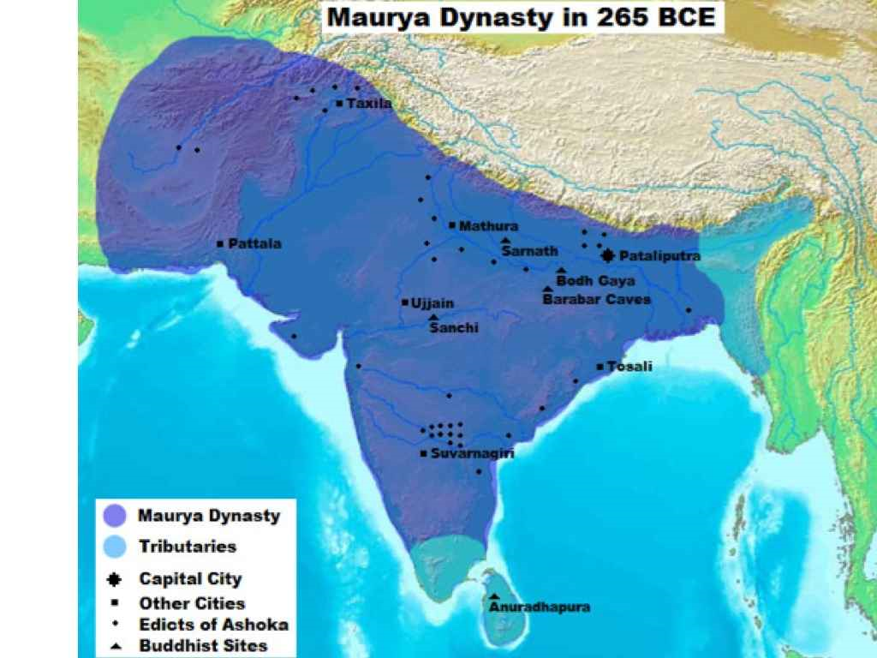
Indian Empires
Notes:
Mauryan Empire

Slide 9
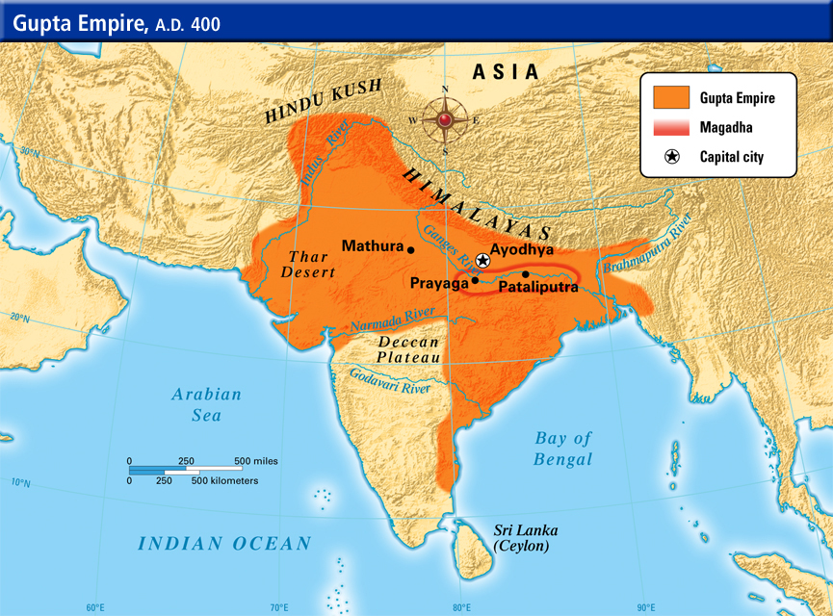
Indian Empires
Notes:
Gupta Empire

Slide 10
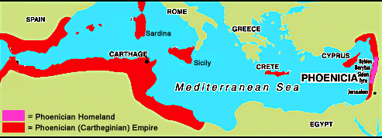
Mediterranean Empires
Notes:
Phoenicia

Slide 11
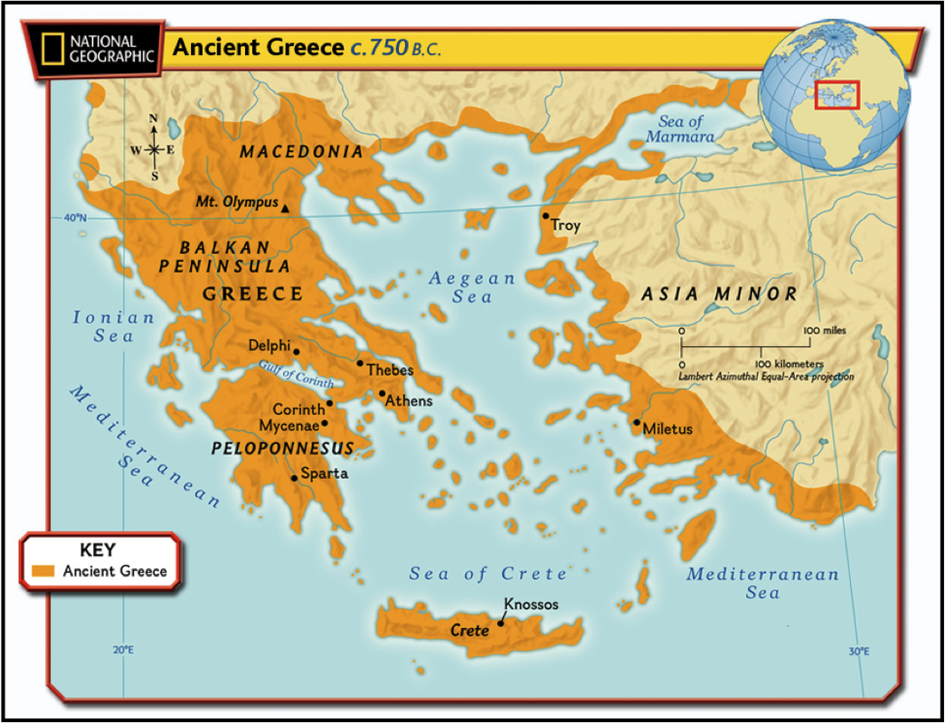
Mediterranean Empires
Notes:
Ancient Greek City States

Slide 12
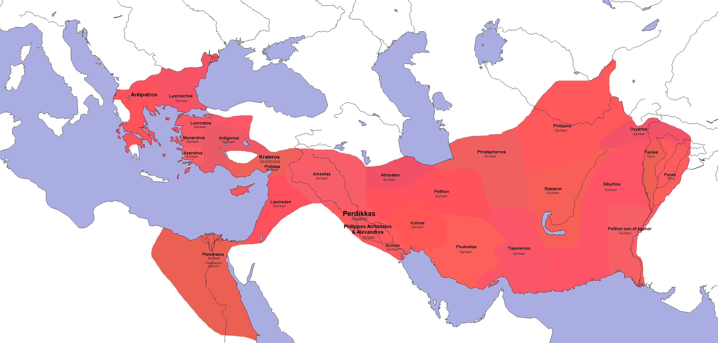
Mediterranean Empires
Notes:
Hellenistic Greece

Slide 13
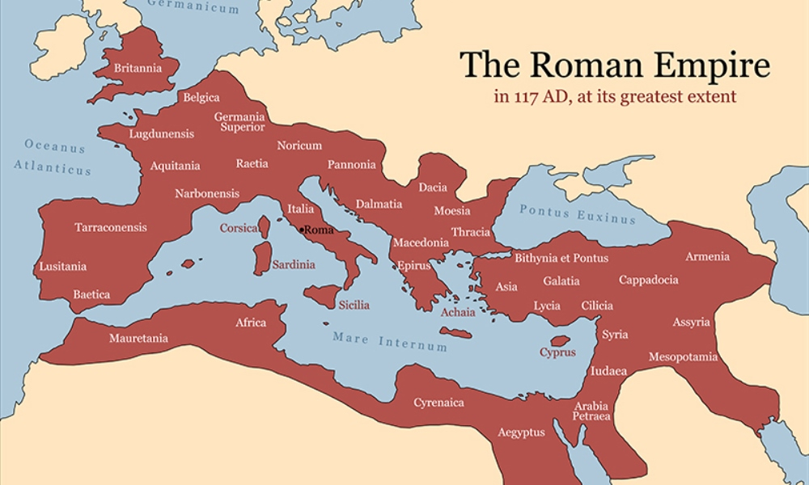
Mediterranean Empires
Notes:
Roman Empire

Slide 14
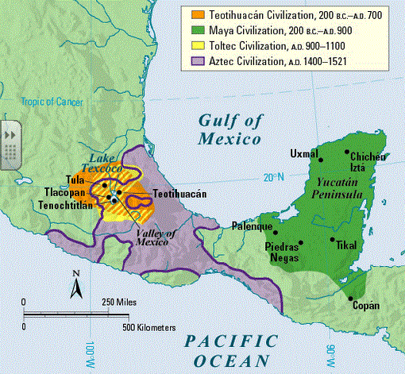
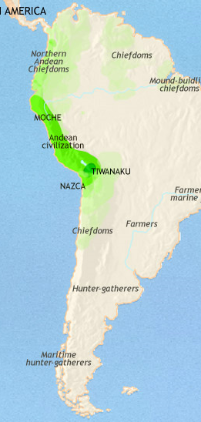
Empires in the Americas
Notes:
Teotihuacan (Precursor to Aztec), Maya, and Moche (Precursor to Inca)

