Slide 1
A.P. World History
Concept 3.2: Continuity and Innovation of State Forms and Their Interactions
Concept 3.3: Increased Economic Productive Capacity and Its Consequences.

Slide 2
Concept 3.2
I. Empires collapsed and were reconstituted; in some ways new state forms emerged.
A. Following the collapse of empires, most reconstituted governments, including the Byzantine Empire and the Chinese dynasties-Suit, Tang, and Song-combined traditional sources of power and legitimacy with innovations better suited to the current circumstances.
Examples of traditional sources of power and legitimacy:
Patriarchy
Religion
Land-Owning Elites
Examples of innovations:
New Methods of Taxation
Tributary Systems
Adaptation of religious institutions
China:
During the Classical Age (Continuity): Han built a foundation with a bureaucracy of merit made of Confucian scholars.
Patriarchy continued to be a dominant in Chinese culture. (Confucian teachings emphasize male dominance)
Changes under the Tang Dynasty:
Equal field system: All land owned by government and distributed to families based on need.
Tributary States: based on their own belief of superiority. Allowed smaller states like Korea to pay a tribute to China in order to remain “independent.”

Slide 3
Concept 3.2
I. Empires collapsed and were reconstituted; in some ways new state forms emerged.
A. Following the collapse of empires, most reconstituted governments, including the Byzantine Empire and the Chinese dynasties-Suit, Tang, and Song-combined traditional sources of power and legitimacy with innovations better suited to the current circumstances.
Examples of traditional sources of power and legitimacy:
Patriarchy
Religion
Land-Owning Elites
Examples of innovations:
New Methods of Taxation
Tributary Systems
Adaptation of religious institutions
Byzantine Empire:
Built on the foundations of classical Rome. Code of Justinian provided a sense of order and security in this diverse empire.
Heavily influenced by Christianity
Military/Political Districts: Each province of Byzantium is placed under the leadership of a general (Responsible for administration and defense).
Emperor is both political head and religious head of the Eastern Orthodox Church.

Slide 4
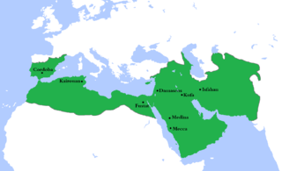
Concept 3.2
I. Empires collapsed and were reconstituted; in some ways new state forms emerged.
B. In some places, new forms of governance emerged, including those developed in various Islamic states, the Mongol Khanates, city-states, and decentralized government (feudalism) in Europe and Japan.
Examples of Islamic States:
Abbasids
Muslim Iberia
Delhi Sultanates
Examples of city-states:
Italian Peninsula
East African
Southeast Asia
Americas
Soon after the death of Mohammed a dispute over who should be the leader of this new religion/polity.
Idea of another prophet inconceivable
A "deputy" or Caliph was chosen to lead the Muslim community.
Disagreement over the qualifications of the Caliph led to the split of Muslims into Shia and Sunni factions.
Presides over the political, religious and military affairs of the Dar al-Islam & became a unifying force on Islamic civilization.
The Umayyad Caliphate (661-750) pushed the boundaries of Islam far outside the Arabian peninsula. (dominated by Arab elites).
In 750 the Umayyads were overthrown by the Abbasids and a new Caliphate was established.

Slide 5
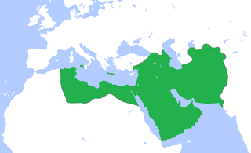
Concept 3.2
I. Empires collapsed and were reconstituted; in some ways new state forms emerged.
B. In some places, new forms of governance emerged, including those developed in various Islamic states, the Mongol Khanates, city-states, and decentralized government (feudalism) in Europe and Japan.
Examples of Islamic States:
Abbasids
Muslim Iberia
Delhi Sultanates
Examples of city-states:
Italian Peninsula
East African
Southeast Asia
Americas
Abbasid Caliphate (750-1258):
Wider variety of cultural influences made their way into Islamic civilization, the most prominent of which was Persian.
No dependence on a Arab military aristocracy like the Umayyads.
End of racial policies of Umayyads.
Abbasids used a salaried bureaucracy.
bureaucrats could be promoted or dismissed at the whim of the Caliph.
Arab militias were replaced by a professional Abbasid army of paid soldiers.
Caliph becomes an absolute ruler presiding over a centralized bureaucratic state and supported by military force

Slide 6
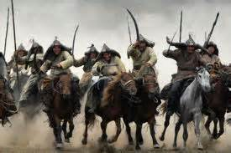
Concept 3.2
I. Empires collapsed and were reconstituted; in some ways new state forms emerged.
B. In some places, new forms of governance emerged, including those developed in various Islamic states, the Mongol Khanates, city-states, and decentralized government (feudalism) in Europe and Japan.
Examples of Islamic States:
Abbasids
Muslim Iberia
Delhi Sultanates
Examples of city-states:
Italian Peninsula
East African
Southeast Asia
Americas
Features of the Mongol Khanate:
Genghis Khan (1162-1227) Tactics:
Intermarriage: blended the conquered tribal bloodlines with his own making tribal distinctions less relevant.
Military Organization: Military unit called an arban (Squad of 10 soldiers). Specifically mixed different tribes into the arban.
Soldiers could travel 100 Miles/Day
Bloodletting provided food on the move
Communication: Used “Arrow Messengers” and stations to relay important communication throughout empire.

Slide 7
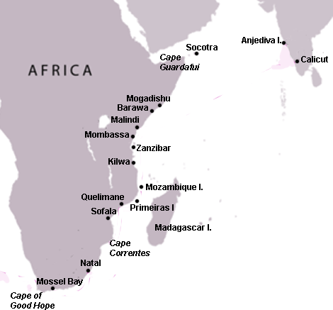
Concept 3.2
I. Empires collapsed and were reconstituted; in some ways new state forms emerged.
B. In some places, new forms of governance emerged, including those developed in various Islamic states, the Mongol Khanates, city-states, and decentralized government (feudalism) in Europe and Japan.
Examples of Islamic States:
Abbasids
Muslim Iberia
Delhi Sultanates
Examples of city-states:
Italian Peninsula
East African
Southeast Asia
Americas
Swahili City-States: Example of a non-centralized political unit.
Swahili is a language that blended Bantu and Arabic.
Predominantly Muslim, but with large populations of Christians, Muslims, Hindu, Confucian, and Buddhist Merchants.
Tolerance is good for business.
Connected Africa to the Indian Ocean Trade Network

Slide 8
Concept 3.2
I. Empires collapsed and were reconstituted; in some ways new state forms emerged.
B. In some places, new forms of governance emerged, including those developed in various Islamic states, the Mongol Khanates, city-states, and decentralized government (feudalism) in Europe and Japan.
Examples of Islamic States:
Abbasids
Muslim Iberia
Delhi Sultanates
Examples of city-states:
Italian Peninsula
East African
Southeast Asia
Americas
Feudalism in Europe & Japan:
European Feudalism (The Dark Ages)
European Military Contact with Islam (The Crusades)
Japanese Feudalism (The Heian Period)
Feudalism in Europe and Japan:
Fall of the Western Roman Empire in 476 resulted in loss of stability and security in W. Europe.
Feudalism is a system of reciprocal relationships between landowners and other members of society.
Both Europe and Japan’s feudalism resulted in the Knight/Samurai class.
Labor from serfs/peasants as well as military service in exchange for protection.

Slide 9
Concept 3.2
C. Some states synthesized local and borrowed traditions.
Examples of synthesis by states:
Persian traditions that influences Islamic states
Chinese traditions that influenced states in Japan
D. In the Americas, as in Afro-Eurasia, state systems expanded in scope and reach: Networks of city-states flourish in the Maya region and, at the end of this period, imperial systems were created by the Mexica (“Aztecs”) and Inca.
Persian Traditions in the Islamic States:
The Abbasid Caliphate was heavily influenced by Persian Culture.
Political Organization & Absolute power of the Caliph
The Veiling of Women
Declining Position of Women in Family & Society: TWO SIGNS:
Harem
The Harem was an Abbasid creation: Wives/Concubines
Concubines were slaves who could gain freedom by bearing sons
One Caliph had 4,000
Most bought/caught in surrounding regions
The Veil
Female seclusion had been practiced in some areas of the ME since Antiquity
Wives/Concubines of Abbasid Caliphs were restricted to forbidden quarters
Some of the best educated people were slaves
Caliphs spent more time with concubines than with their wives
Slave women were free to travel and did not have to wear the veil
Poor women worked
Rich women had no career options
Most married at 9
Devoted life to serving husbands
Women & Concubines maneuvered to get their sons succession to the throne/inheritence.
By the end of the Abbasids, the freedom & influence women had enjoyed early on had declined.

Slide 10
Concept 3.2
C. Some states synthesized local and borrowed traditions.
Examples of synthesis by states:
Persian traditions that influences Islamic states
Chinese traditions that influenced states in Japan
D. In the Americas, as in Afro-Eurasia, state systems expanded in scope and reach: Networks of city-states flourish in the Maya region and, at the end of this period, imperial systems were created by the Mexica (“Aztecs”) and Inca.
Chinese Influence on Japan
Unlike Korea and Vietnam who acquired Chinese influences through invasions, the Japanese chose to emulate the Chinese.
The Japanese could not help but notice the successes and power of their Tang neighbors.
The government embarked on a course of transformation known as the Taika Reforms (645C.E.)in which they copied many of China's successes.
Centralize the state by means of a Confucian based bureaucracy.
Chinese written language entered Japan
Japanese borrowed the Chinese equal field system of agriculture.
Buddhism also poured in to Japan, as it did in Korea and Vietnam.

Slide 11
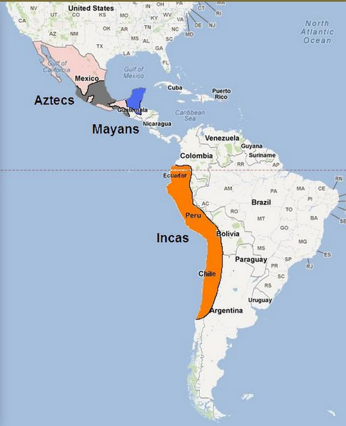
Concept 3.2
C. Some states synthesized local and borrowed traditions.
Examples of synthesis by states:
Persian traditions that influences Islamic states
Chinese traditions that influenced states in Japan
D. In the Americas, as in Afro-Eurasia, state systems expanded in scope and reach: Networks of city-states flourish in the Maya region and, at the end of this period, imperial systems were created by the Mexica (“Aztecs”) and Inca.
The Maya, Aztec, & Inca
The Maya (whom we’ve talked previously appeared in Unit 2 (250-900C.E.) go through a decline and the a resurgence between 1200-1450 C.E.
City-State like kingdoms similar to Ancient Greece.
The Aztec come to prominence after the end of the Toltec Empire in 1200 C.E.
12 Million People
Culture and religion deeply rooted in the belief that the gods were in a constant struggle against the stars. (Required the blood of sacrifice)
Used the silt/muck of lakes to create islands of agriculture called chinampas.
Elaborate trade and tribute system

Slide 12
Concept 3.2
II. Interregional contacts and conflicts between states and empires encouraged significant technological and cultural transfers.
Examples of technological and cultural transfers:
1. Between Tang China and the Abbasids
2. Across the Mongol Empires
3. During the Crusades
Major Interregional conflicts of the Period:
Tang China & The Abbasids
Battle of Talas in 751 C.E.: Victory of the Islamic Caliphate over Chinese Expansion into Central Asia.
Exchanges:
Central Asia becomes primarily Islamic and Buddhism declined in the region.
Transfer of Paper-Making from China to the Islamic World.
Exchange Around The Mongol Empire
Islamic mathematics and astronomy spread from the Dar la Islam into China. The Chinese made advanced calculations in these areas which then made their way back to the Muslim world.
Algebra
Accurate readings of the heavens were very important to Daoism and Shamanism, both of which depended on astrological readings to plan weddings, feasts and agriculture.
Geography and cartography: Scholars combined geographic information from China to the Middle East into the most accurate maps in the world at that time thus enabling the later Ming Dynasty to initiate its famous explorations (Zeng He and Ma Huan).
In the world of food and agriculture, the Pax Mongolia allowed for the transfer of grapes and fruit trees to China. In return, luxury items of Chinese cuisine, such as pepper, cinnamon and tea, were introduced into the Muslim world.
Perhaps the most important technological transfers during the Pax Mongolia were block printing and gunpowder.

Slide 13
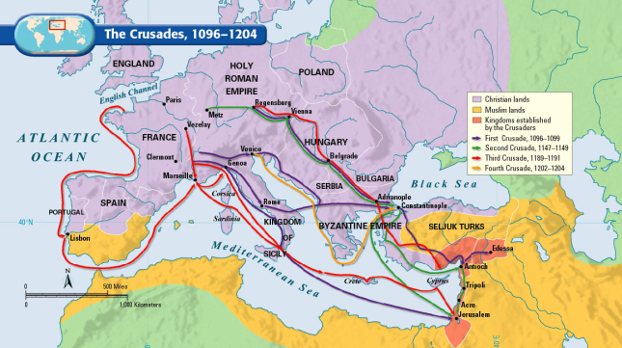
Concept 3.2
II. Interregional contacts and conflicts between states and empires encouraged significant technological and cultural transfers.
Examples of technological and cultural transfers:
1. Between Tang China and the Abbasids
2. Across the Mongol Empires
3. During the Crusades
Major Interregional conflicts of the Period:
The Crusades: Historians argue over whether the Crusades caused the exchange of information and technology from east to west.
Arabic Numerals and The Decimal System
Food: Yogurt, Coffee, Sugar, Dates
Science and Medicine
Philosophy lost during the fall of Rome but preserved by Arabic Scholars (Aristotle)

Slide 14
Key Concept 3.3 Increased Economic Productive Capacity and Its Consequences.
Innovations stimulated agricultural and industrial production in many regions.
During this period agricultural technology improves, humans begin transporting indigenous species to equivalent climates. Trade good production increases.
The Decline and Renewal of Urban Centers…
Important Changes in the way labor is managed throughout the world.
Social Structures remain largely unchanged, new forces of labor emerge, and religious diffusion contributes to changes in family and gender relations.

Slide 15
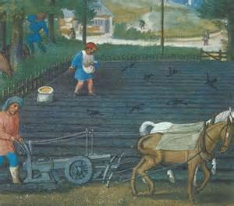
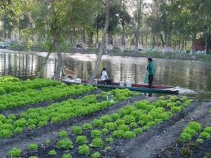
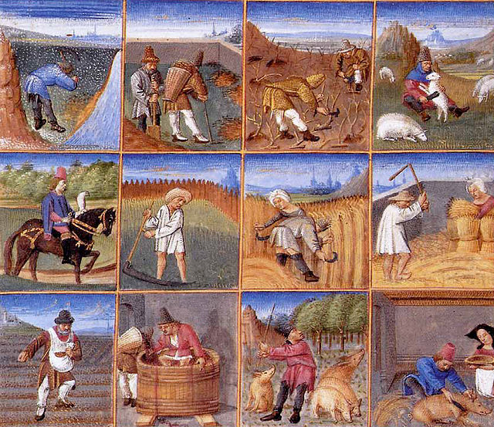
Agricultural Innovation
New technologies that appear during this period include:
Intensified Irrigation (Roman & Muslim), Crop Rotation, Agricultural Manuals.
New Technology = Better Agriculture
Chinampas in Mesoamerica
Horse Collar & Plow in W. Europe
Champa Rice in China
The demand for variety/similarity helps lead to the diffusion of agriculture to locations of similar climate,
Also the demand for luxury goods produced in Persia/India increased leading to higher production & trade.
Iron/Steel Production in China

Slide 16
Downfall of Cities ATHENS, ROME, ALEXANDRIA, CHANG’AN, PATALIPUTRA
Invasions: All of the classical societies fell to invaders. In their wake, Feudalism took root as the socio-political standard of the period.
Rome: Visigoths, Ostrogoths, Vandals
Gupta: White Huns
Han: Xiongnu
Diseases: Increased classical (Period 2) trade led to the spread of diseases.
Justinian’s Plague 6th Century kills ¼ of Europe
Smallpox/Measles kill ¼ of Chinese population in 7th Century
Agricultural Decline: Lack of Political authority/safety equals decreased agricultural output. There was not enough food production to feed a large urban center.
The Little Ice Age: Temperatures during this time dip a little in the Northern Hemisphere…
People during this time period are not technologically equipped to handle the climate change and crops suffer.

Slide 17
Rise of Cities NOVGOROD, TIMBUKTU, HANGZHOU, CALICUT, BAGHDAD, MALACCA, VENICE
Invasions End: Germans settled into Europe. White Huns settled into the Caste System of India. The Xiongnu integrated into Chinese society as well.
Safe/Reliable Transportation: Several large empires will form in this era. These empires provide safety, including safe trade routes, allows for new centers of trade/commerce to arise leading to prosperity.
Increased Agriculture & Population: Agriculture expanded greatly during this period. In Europe, they had the “Great Clearances” which vastly increased the amount of arable land. Plus, formerly sparsely populated areas were populated with more and more people. Food + Peace = Population.
Availability of Labor: If you add up the above factors, you come to one conclusion: There is less invasion, more trade, more food, and more people. So, there is also a greater availability of LABOR.

Slide 18
Changes in Labor Management & Organization
Labor Management
Free Peasant Agriculture: is what you probably think of when you think of “peasants”
They are the majority of populations where they exist.
Peasants are typically small farm owning rural farmers.
Nomadic Pastoralism: Think of them as peasants without arable land. They follow their animals from pasture to pasture depending on the season.
Generally associated with warrior-based cultures that became fearsome to settled people.
They tend to move around 150 miles per year (in rotation). Examples: Cattle, Yaks, Sheep, Goats, Reindeer, Horses, Donkeys, Nerfs

Slide 19
Changes in Labor Management & Organization
Guilds: A collection of craftsmen of a similar trade. Their goal is to regulate their industry (price/labor salary)
Originally organized similarly to a trade union or secret society.
Apprentice, Journeyman, and Master all come from Guilds.
Coerced: This is any kind of forced labor on the lowest in a societies social hierarchy. Two examples:
Serfdom (Europe/Japan): Tied to a specific plot of land for a Lord in return for protection. They are the lowest class of Feudal society.
Mita (Inca): Unpaid required labor owed to the Empire. Used on large community projects.

Slide 20
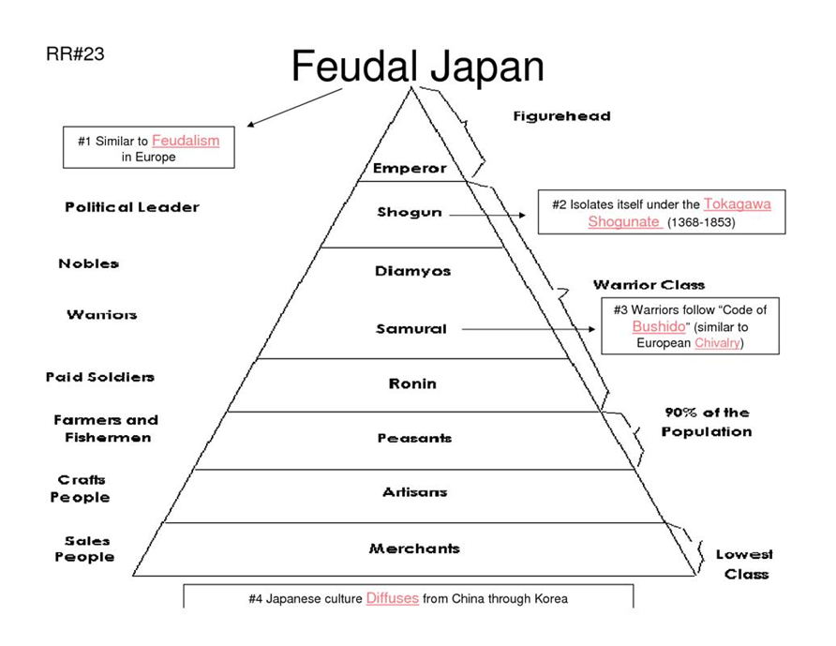
Changes in Labor Management & Organization
Government Imposed Labor Taxes: While taxation isn’t new. These Medieval taxes were paid to the ruling class (usually to the King).
Often on land or custom duties (taxes paid on moving from place to place). I.E.: Geld: was raised in England starting in 1012 to pay for mercenaries.
Later replaced with taxes on personal income and property.
Military Obligation: In Feudal societies peasants/vassals would owe military service for their Lord in return for land usage.
Not everyone was happy with these arrangements and numerous peasant revolt occur (although none have significant success)
Specifically China and the Byzantine Empire experience numerous revolts, all fail.

